Slide 1
Finding the Safest Neighborhood in
Vancouver
Ankur Roy

Slide 2
Background
u The Canadian city of Vancouver is located in the Lower Mainland region of British Columbia. The Greater Vancouver area has a population of about two and a half million, making it the third-largest metropolitan area in Canada. Criminal activity, like breaking and entering or theft, is prevalent throughout this area and can greatly impact business owners. It is therefore important for a new business owner to take crime statistics into account when selecting which neighbourhood, they would like to open their business. By analysing crime data in Vancouver, we aim to determine the safest neighbourhood that is also suitable for opening a small business like a grocery store.

Slide 3
Problem
u will involve first analysing crime data to shortlist safe neighbourhoods where grocery stores are not too common. Using various data science tools, we will pick the safest borough, and then look at its neighbourhoods, before looking at the most common businesses in each neighbourhood in order to select the neighbourhood that has both low crime and a low number of grocery stores.

Slide 4
Data Acquisition
u To fetch the crime details of Vancouver I used real world data set published on Kaggle. Though this dataset included type of crime, recorded time and coordinates of the criminal activity along with neighbourhood, the neighbourhoods were not properly categorized into boroughs which I fetched from Wikipedia. Further the coordinates of the data has been fetched using the OpenCage Geocoder API. Foursquare API is used to fetch venues for the listed neighbourhoods.
u The second source of data is based on data from a Wikipedia, which was not didn’t require any scraping as it was direct categorizations. The page contains additional information about the neighbourhood and boroughs. The third data source is generated from OpenCage API
u The third data source is generated from OpenCage API

Slide 5
Data Cleaning
u Data from the kaggle data source was heavy file which Git could not accommodate. The Vancouver Crime report had close to ~600,000+ rows of information. Because of the sheer size of the dataset, we choose to take into consideration recent most crimes of the year 2018 which would greatly reduce the number of row in the dataset.
u Since the original data source couldn’t be uploaded to git I processed the dataset in the runtime to filter the records of crimes that took place in the year 2018, created a new csv out of it using pandas and uploaded it to git hub repository.
u Due to improper encoding of the co-ordinates of the crime record, the exact same coordinates from the data couldn’t be used for plotting because the co-ordinates seemed to be corrupted. Along with X,Y columns in the dataset which represented the GPS co- ordinates of the criminal activity, other fields such as month and hour in which the crime took place has been dropped because they were not in the scope of the problem.

Slide 6
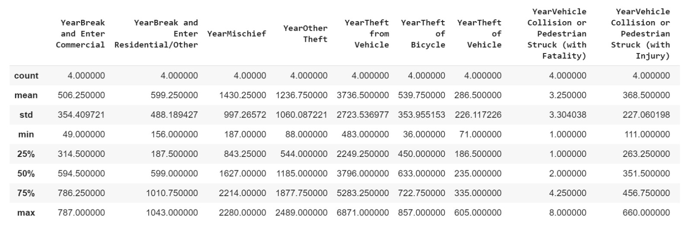
Methodology
The describe function in python is used to get statistics of the crime data, this returns the mean, standard deviation, minimum, maximum, 1st quartile (25%), 2nd quartile (50%), and the 3rd quartile (75%) for each of the crime categories.

Slide 7
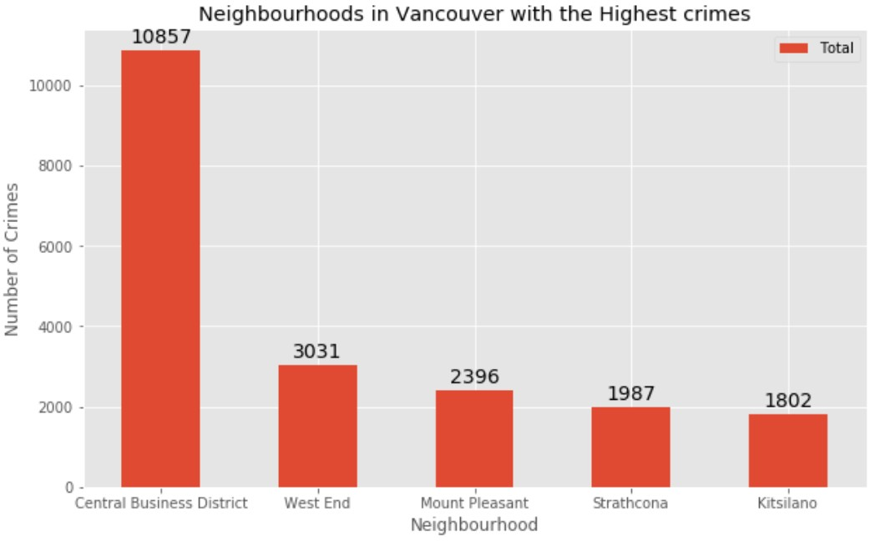
Data Visualisation

Slide 8
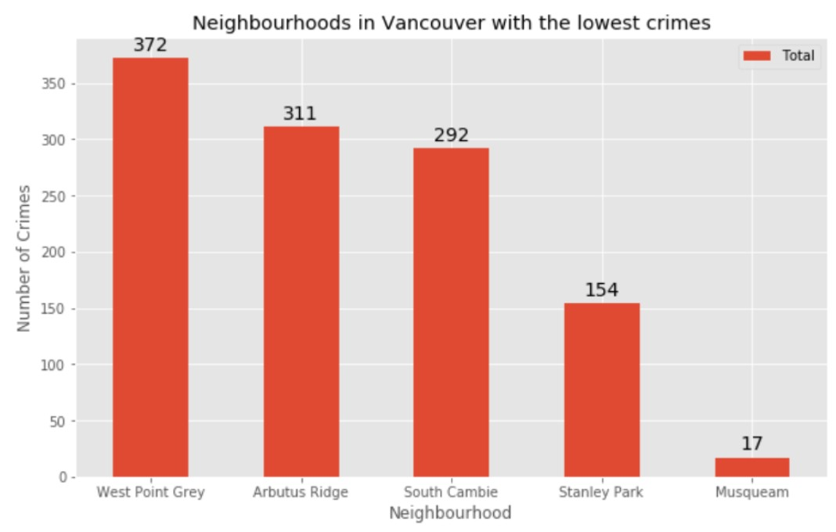

Slide 9
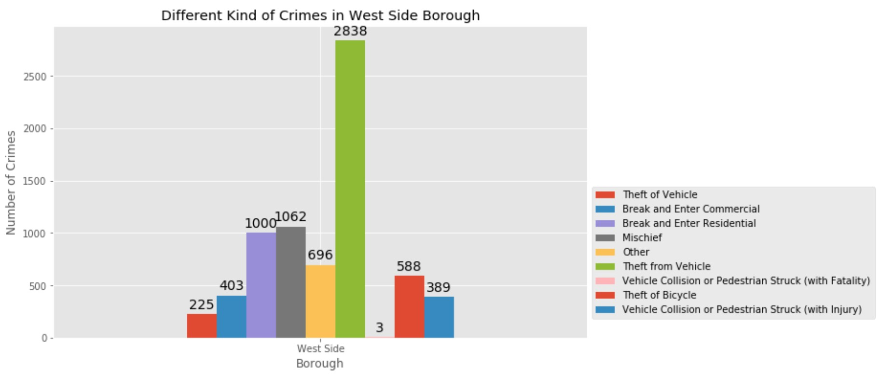

Slide 10
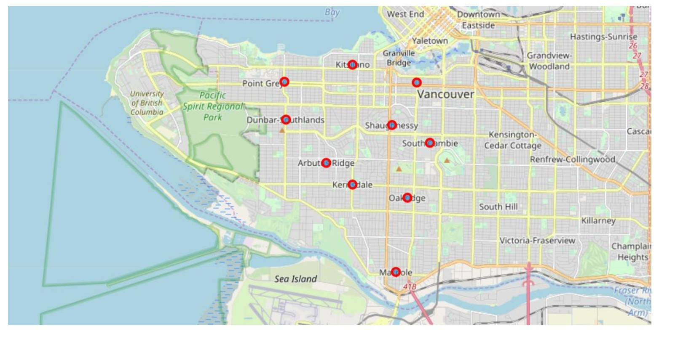
West Side Neighborhoods

Slide 11
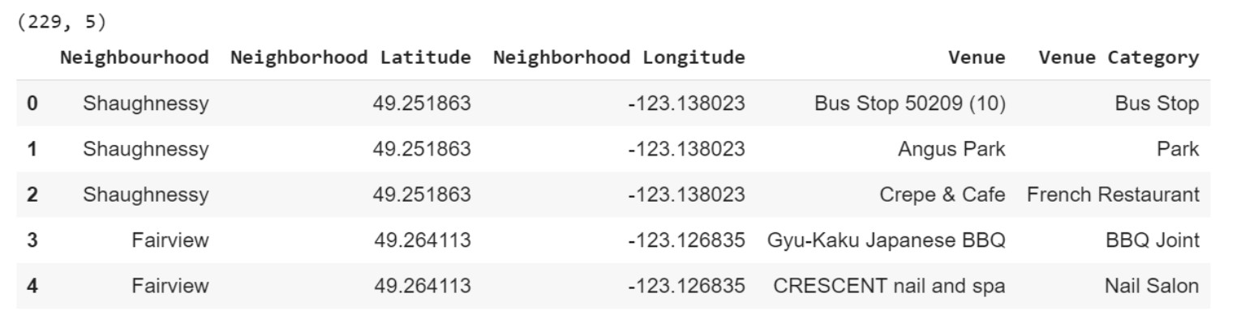
Modelling
Based on the final dataset of neighbourhood and borough along with latitude and longitude of neighbourhoods in West Side Vancouver, we can find all the venues within a 500-meter radius of each neighbourhood by connecting to the FourSquare API. This returns a response in json format containing all the venues in each neighbourhood which we convert to a pandas data frame. This data frame contains all the venues along with their coordinates and category will look as follows:

Slide 12
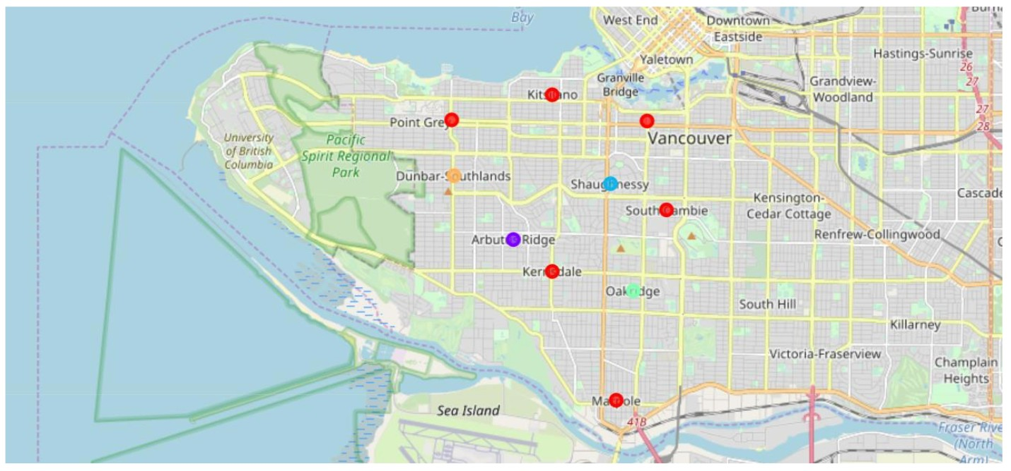
Results
After running the K-means clustering we can access each cluster created to see which neighbourhoods were assigned to each of the five clusters. Here is how the map looks like:

Slide 13
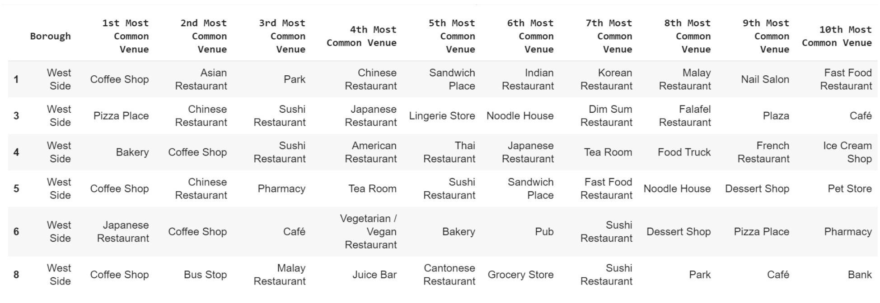
The data of Cluster contains the following neighbourhoods

Slide 14
Discussion
u The objective of the business problem was to help stakeholders identify one of the safest borough in Vancouver, and an appropriate neighbourhood within the borough to set up a commercial establishment especially a Grocery store. This has been achieved by first making use of Vancouver crime data to identify a safe borough with considerable number of neighbourhoods for any business to be viable. After selecting the borough it was imperative to choose the right neighbourhood where grocery shops were not among venues in a close proximity to each other. We achieved this by grouping the neighbourhoods into clusters to assist the stakeholders by providing them with relevant data about venues and safety of a given neighbourhood.

Slide 15
Conclusion
u We have explored the crime data to understand different types of crimes in all neighbourhoods of Vancouver and later categorized them into different boroughs, this helped us group the neighbourhoods into boroughs and choose the safest borough first. Once we confirmed the borough the number of neighbourhoods for consideration also comes down, we further shortlist the neighbourhoods based on the common venues, to choose a neighbourhood which best suits the business problem. The future scope of this project we can take into considerations population of the neighbourhood which is an additional factor that will have major impact on decision making.

